Slide 1
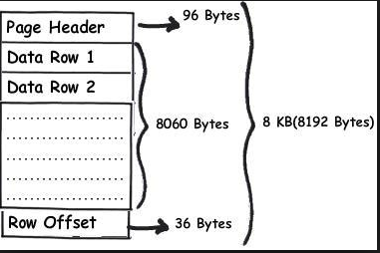
WHAT IS A SQL PAGE?
A SQL page is the fundamental unit of data storage in SQL Server. It’s 8KB in size
A SQL page consist of 8KB (8192 bytes)
The SQL page consists of 3 sections
Page header: 96 bytes
Row(s) of data: 8060 bytes per page
Row offset: 36 bytes

Slide 2
Why is it important to understand the page size and its purpose?
As we saw on the previous slide, of the 8192 bytes on a page, approximately 8060 are available for inserting rows of data. If you design data rows that can fit into a single page then they'll take up a lot less storage (a lot less storage and less scanning of pages make for better performance)
If for example, your have a row of 4200 bytes long then only a single row will be stored on a page (and the rest of the page - 3860 bytes - is wasted space). Thus, the important point is you want to try to avoid large areas of space that cannot hold any useful information on a page.
If you redesigned the row size to 4000 bytes, then suddenly you can store two rows on a page, and thus significantly reduce the overhead of wasted space.
This management of page size also play and important role in managing page splitting which can cause performance issues (to be discussed later.)

Slide 3
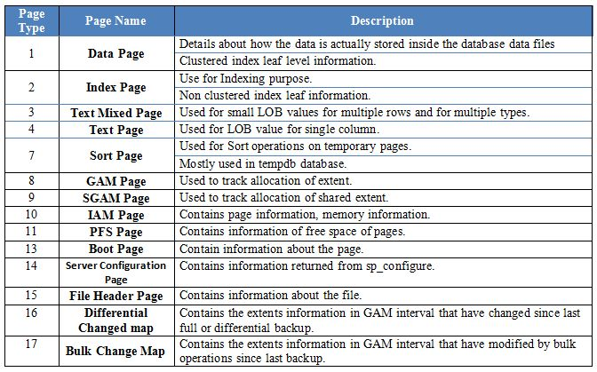
TYPES OF SQL PAGE?
There are many types of SQL pages. The following illustrates the type of pages: We will focus on data page, index page and IAM page. Note the page type. 1 = data page, 2 = index page and 10 = IAM page.

